Slide 1
Predicting MLB All-Stars
UNC Group 1
Christian Albertini
Hannah Shelton
Zach Mason
Folly Gbegnon

Slide 2
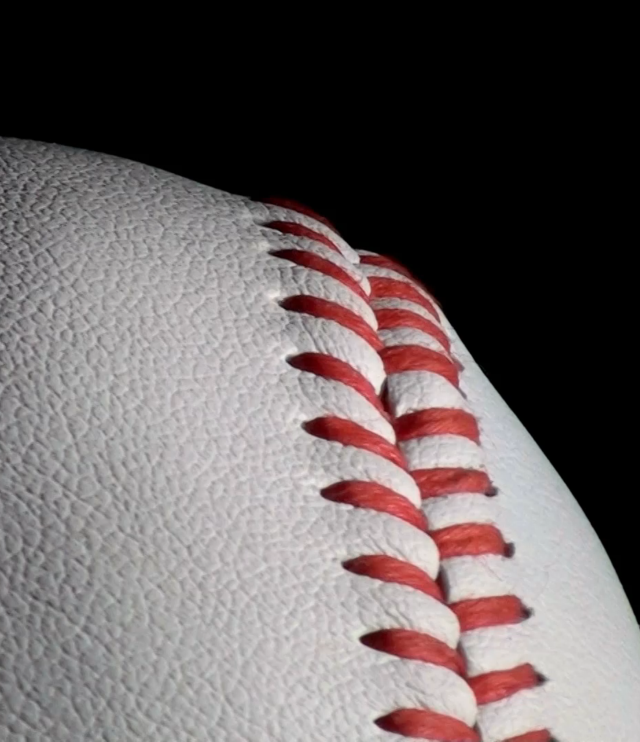
Executive Summary
The scope of our project is predicting MLB All-Stars based on end-of-season statistics
The source of our data is Baseball-Reference (link)
The requirements for this project where:
Find a problem worth solving, analyzing, or visualizing.
Use machine learning (ML) with the technologies we’ve learned.
You must use Scikit-learn and/or another machine learning library.
Your project must be powered by a dataset with at least 100 records.
You must use at least two of the programs used in class
This project resulted in:
Logistical Regression and Random Forest models
A SQL database
2100+ records retrieved
Visualizations
Ability to enhance model in the future

Slide 3
Project Goals
Retrieve data on baseball players end-of-season statistics from 2013 to 2023
Clean data and store in SQL database
Create model to predict which players were All-Stars each season
Create visualizations to display our efforts

Slide 4
Steps
Find datasets and decide what stats we need
Clean and merge datasets
Create SQL database to house cleaned dataset
Create and run machine learning models
Create visualizations to show results
Analyze results and change parameters of models to boost performance

Slide 5
Finding, cleaning and merging datasets
This step took us a significant portion of time because as we went along, we found new stats that could be helpful in making our model more accurate and would need to find the data needed and merge these datasets together
We used Baseball-Reference to acquire many end-of-season statistics for MLB players who played more than 80 games, such as hits, batting average, wins-above-replacement (WAR), and the final standings for their team at the end of the season
We used Pandas to clean and merge our datasets

Slide 6
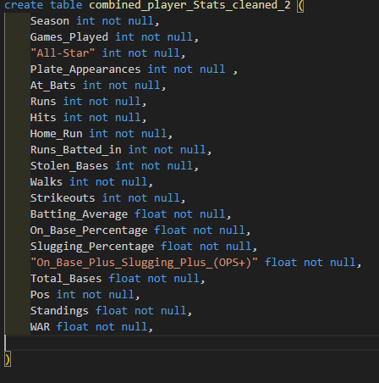
Creating a sql database
We used pgAdmin and created a database to hold our cleaned dataset
We wrote a schema to create the table to house the data
We then imported the data into SQL

Slide 7
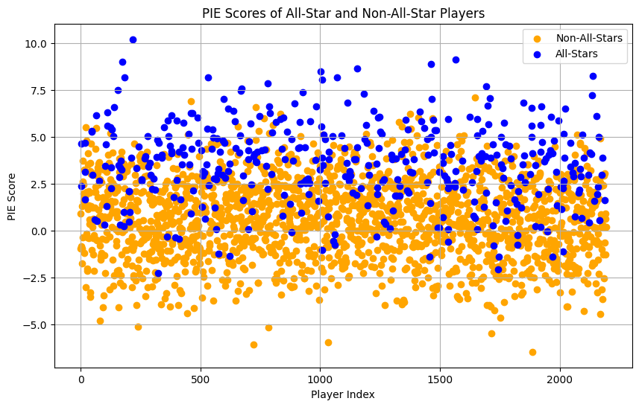
Identify PIE Scores and Outliers
Due to the nature and fan bias of All-Star selections, we used their PIE score to evaluate each player
The scores were then plotted using a scatter plot to identify potential outliers that could distort the data and affect the model’s accuracy

Slide 8
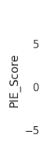
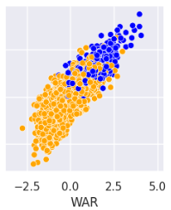
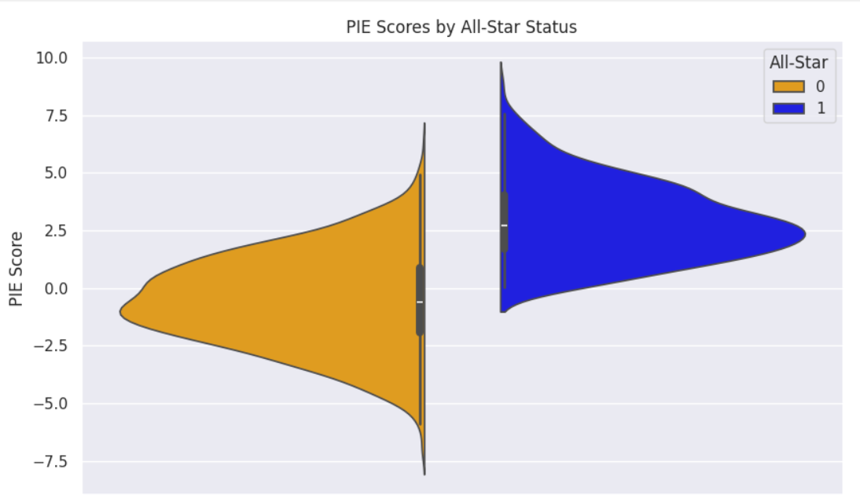
Creating visualizations
We then created visualizations to show how the model was looking at the datasets when it was learning
We captured the classification reports for significant models using screenshots

Slide 9
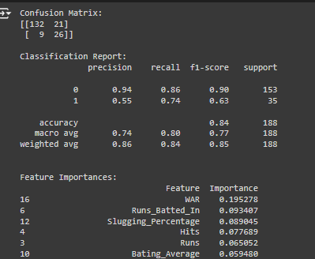
Creating, running and upgrading Ml models
We used Google Colab and wrote Jupyter Notebook files to run our models
We tested both logistic regression models and Random Forest models
As we ran more tests, we were able to improve our model’s performance by changing parameters, such as activation functions and number of estimators
We used SMOTE to help account for the imbalance in our dataset
This led to greater accuracy and recall, which was the primary statistic we were looking at
This is because we wanted our model to correctly predict All-Stars more than just getting who wasn’t an All-Star correct

Slide 10

Limitations
Because All-Star selections are partially based on fan-voting and manager selections, it is not exactly one-to-one that the best statistical players each season are selected as All-Stars
Some factors that influence All-Star selections are the size of a team’s fanbase, team success, prior achievements, and name recognition. Each of these adds bias that affects our model
Only 40 batters are selected as All-Stars each season out of hundreds of players, so the dataset is very imbalanced, which can affect our model’s performance
We attempted to combat these limitations by using SMOTE and adding new stats including end-of-season standings for each player’s team

Slide 11
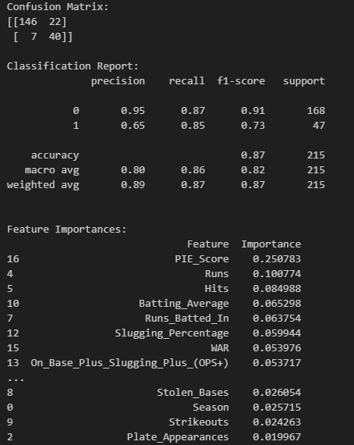
Our findings
We were able to create a model that achieved classification accuracy of over 75% consistently with weighted recall of around 80%
We attempted to run our model without SMOTE and found that our classification report numbers improved greatly, which shows that our model is better at finding non-All Star players when the dataset is imbalanced
Because All-Star selections are not solely on merit but are a fan-voted award, it is impossible for our model to account for players who were voted in but didn’t have great seasons with the data available to us, which prevents our model from being more accurate

Slide 12
Next steps
If possible, finding additional statistics could allow the model to improve its accuracy
Expanding the scope to include more than 2013-2023 could test our model in different ways, as changes in baseball as a sport could lead to some statistical seasons being All-Star caliber at one point and not at other times
We could also expand the dataset by reducing the minimum number of games played to be included from 80, which could let our model see more players and distinguish between All-Star and not better

Slide 13
THANK YOU
Christian Albertini
Hannah Shelton
Zach Mason
Folly Gbegnon

